Slide 1

EduHub MongoDB Backend Project
An Online E-Learning Platform Database Solution
Presenter: Nnamdi Duruike
Course/Program: Data Engineering
Date: 05-10-2025

Slide 2




Why MongoDB? Our Design Philosophy & Tech Stack
NoSQL Choice (MongoDB):
Tech Stack:
Flexibility: Schema-less nature ideal for evolving e-learning content and user data.
Database: MongoDB v8.0+
Scalability: Horizontal scaling capabilities (sharding) for future growth of users/courses.
Language: Python 3.9+
Performance: Fast read/write operations for high-traffic web applications.
Driver: PyMongo
Developer Experience: Intuitive JSON-like document model.
Tools: Pandas (for data display), Jupyter Notebook (for demonstration)

Slide 3

Core Data Model: Collections & Application-Level References
Key Collections:
Relationship Strategy: Application-Level References
Embedded Documents:
users: Students & Instructors (e.g., userId: "S001")
MongoDB uses flexible document models. We link documents by storing _id or unique custom IDs (like userId, courseId) in related collections.
Used for tightly coupled data that doesn't often change independently.
courses: Course details (e.g., courseId: "C001")
Example: profile object within users document (bio, skills).
enrollments: Student-course relationships (e.g., enrollmentId: "E001")
Example: enrollments collection contains studentId and courseId.
lessons, assignments, submissions
Benefit: Prevents data duplication, allows for flexible querying using $lookup for joins.
courses (courseId)
users (userId)
enrollments (enrollmentId)

Slide 4

Ensuring Data Integrity: Validation & Constraints
Schema Validation ($jsonSchema):
Unique Indexes:
Implemented directly on the MongoDB collections (users, courses, enrollments).
Ensures uniqueness for critical fields like users.email.
Crucial for preventing duplicate user accounts.
Enforces data quality before insertion/update.
Examples:
required fields (email, title).
bsonType checking (string, date, number).
enum for restricted values (role: ['student', 'instructor'], level: ['beginner', 'intermediate', 'advanced']).
pattern for email format.
Soft Deletes (isActive flag):
Instead of permanently deleting users, we set isActive: false.
Maintains historical data and preserves referential integrity for past enrollments/submissions.
{ "bsonType": "object", "required": ["email"], "properties": { "email": { "bsonType": "string", "pattern": "^.+@.+$", "description": "must be a string and match the email pattern" } }}

Slide 5
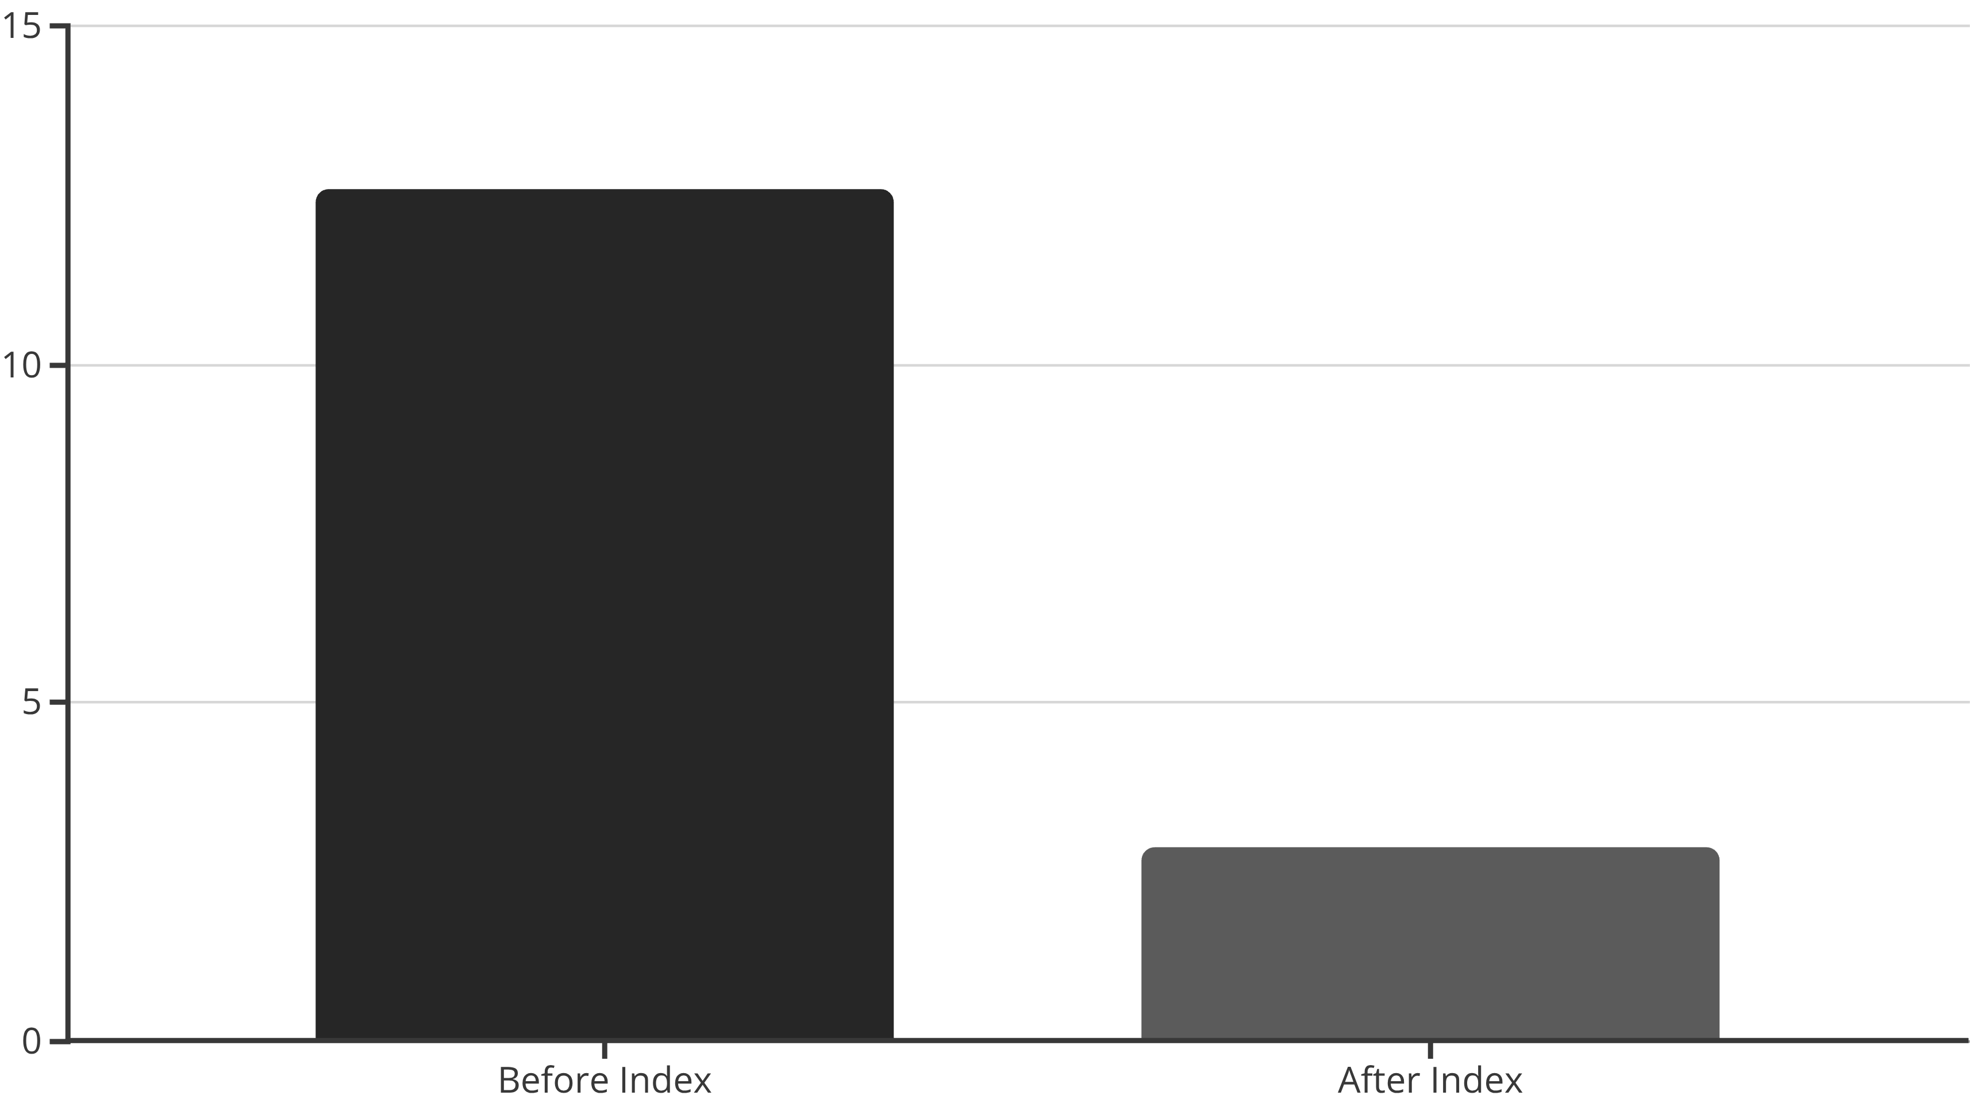
Boosting Performance: Strategic Indexing
1
2
3
Why Indexing?
Key Indexes Implemented:
Performance Analysis (Example):
Significantly speeds up data retrieval operations.
users.email: Unique index for fast user lookup and login.
Query: Finding assignments for a course, sorted by due date.
Crucial for queries involving filtering ($match), sorting ($sort), and joins ($lookup).
courses.category, courses.title: Compound index for efficient course search and filtering.
Before Index: ≈12.58 ms (Collection Scan)
After Index: ≈2.85 ms (Index Scan)
assignments.courseId, assignments.dueDate: Compound index for quick retrieval of assignments for a course, ordered by due date.
Result: ~77% performance improvement
enrollments.studentId, enrollments.courseId: Compound index for checking specific student enrollments.
This chart illustrates the significant performance improvement achieved through strategic indexing.

Slide 6

Unlocking Insights: The Aggregation Framework
01
02
Powerful Pipelines:
Example: Instructor Analytics
MongoDB's aggregation framework allows for complex data transformations and analytics on the server. Used for tasks that go beyond simple CRUD, combining data from multiple collections.
Goal: Calculate the total number of distinct students taught by each instructor.
Pipeline Stages:
$lookup: Joins courses with enrollments to get student data.
$unwind: Deconstructs the enrollments array.
$group: Groups by instructorId, uses $addToSet to count distinct studentIds and courses.
$lookup: Joins with users to get instructor names.
$project: Formats the final output.
03
Output:
Reveals top instructors by student reach, helping identify popular educators.

Slide 7





Conclusion & Future Enhancements
Achievements:
Future Enhancements (Bonus Challenges):
Successfully designed and implemented a robust MongoDB backend for EduHub.
Full-Text Search: Implement text indexes for fuzzy search on course content.
Demonstrated comprehensive understanding of MongoDB features (modeling, CRUD, aggregation, indexing, validation).
Recommendation System: Use aggregation to suggest courses based on enrollment history.
Data Archiving: Strategy for managing old enrollment records to maintain performance.
Ensured data integrity and optimized query performance.
Challenges Faced:
Managing application-level referential integrity without built-in foreign keys.
Optimizing complex multi-collection analytical queries.

Slide 8

Thank You!

